Slide 1
JMeter Overview
Dang Thi Thao My

Slide 2
Vocabulary
Test Plan – JMeter script
Thread Group – thread = user
Samplers – makes a request
Config Elements
Timer – add a delay
Listener – reporting, logging, and debugging
Assertions – error checking
Pre processor – modify the request
Post processor – parse the response
Logic Controller
WorkBench – temp working space

Slide 3
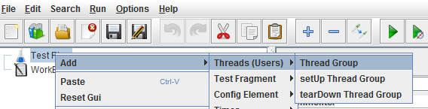
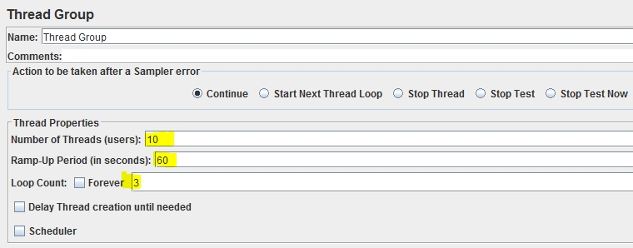
Simple ex. add Thread Group
How long does it take to go from 1 to 10 users
How many times to run the script

Slide 4
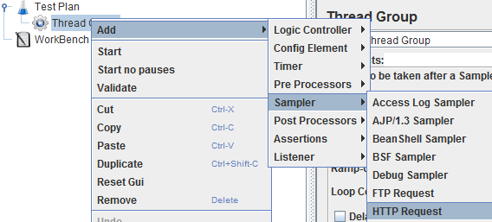
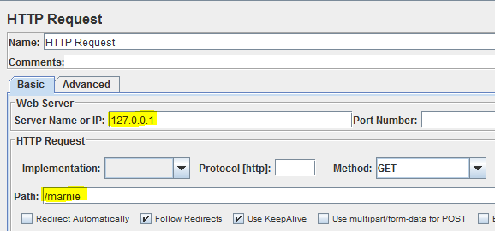
Simple test add HTTP Request

Slide 5
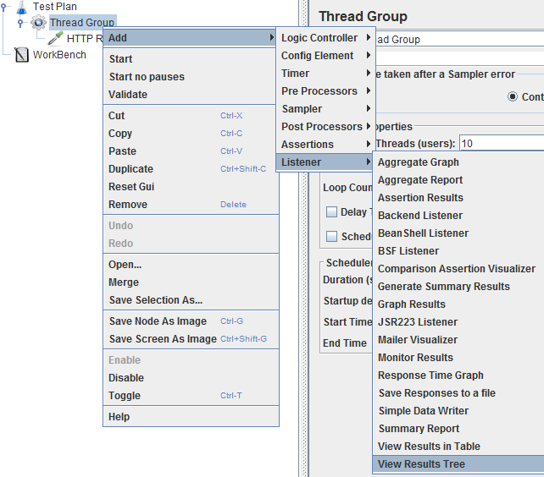
Simple test add Listener

Slide 6

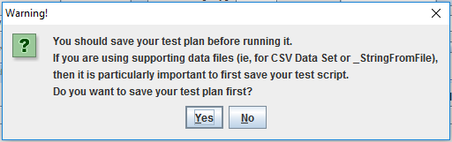
Simple test Run

Slide 7
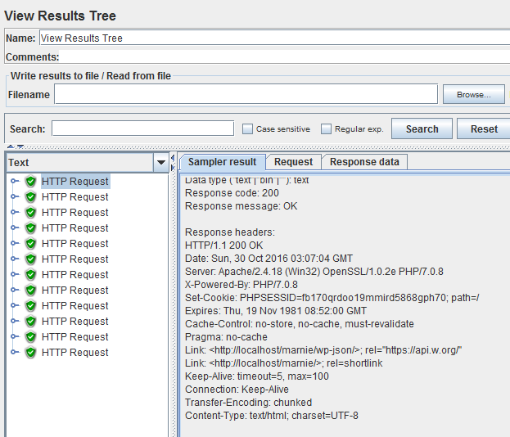
Simple test View Results Tree

Slide 8
Record
How do we have a test script?

Slide 9
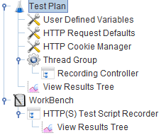
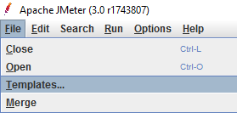
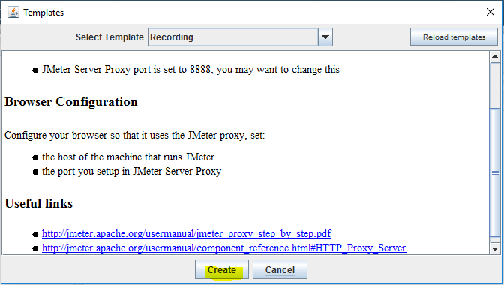
Record create templates

Slide 10
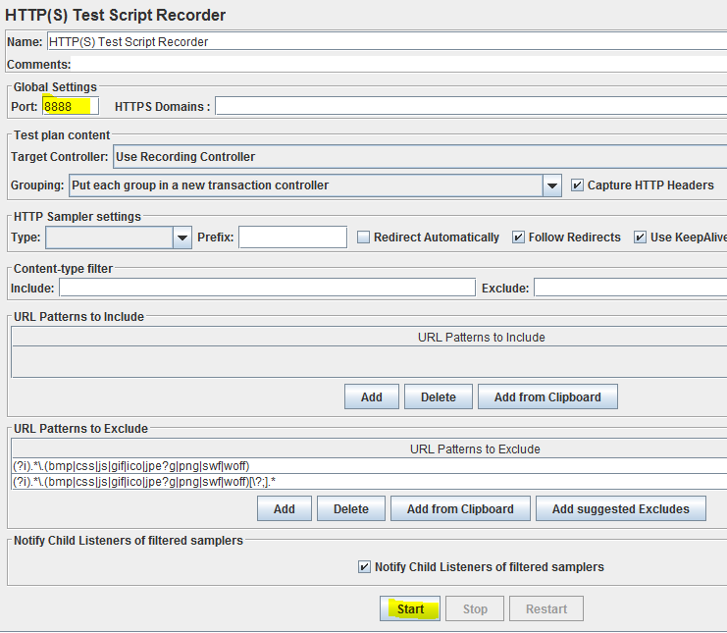
Record start

Slide 11
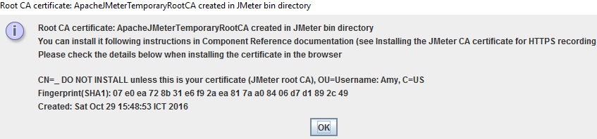
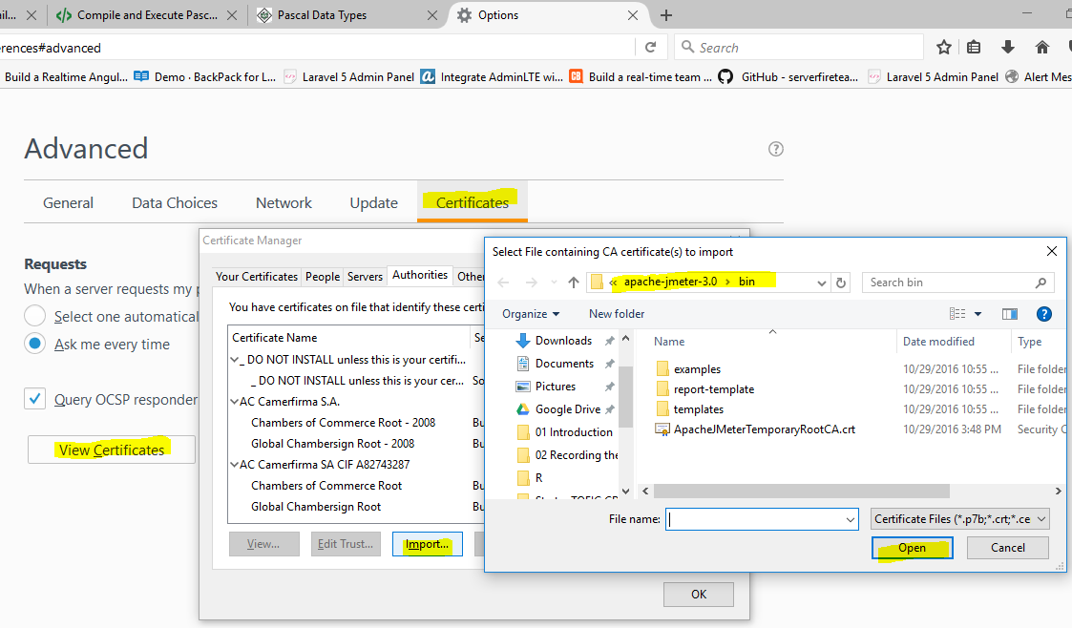
Record add Cert to Browser

Slide 12
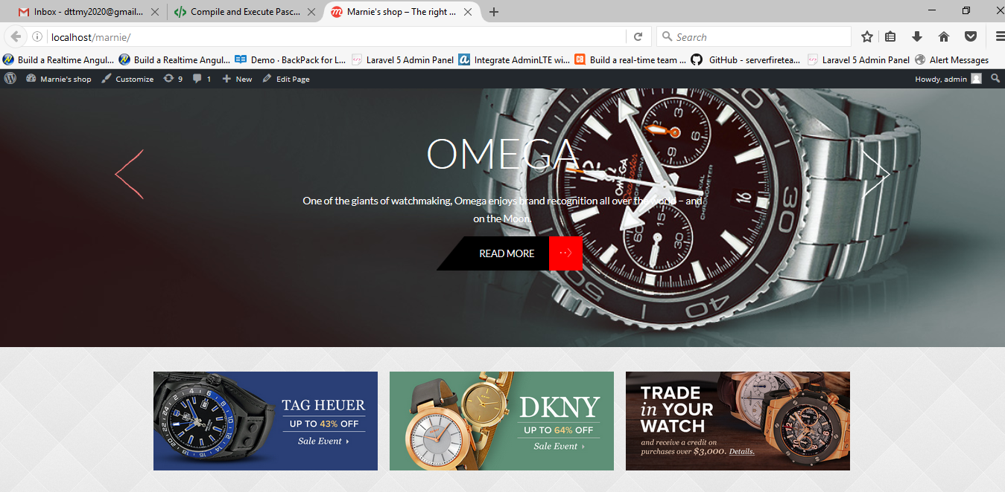
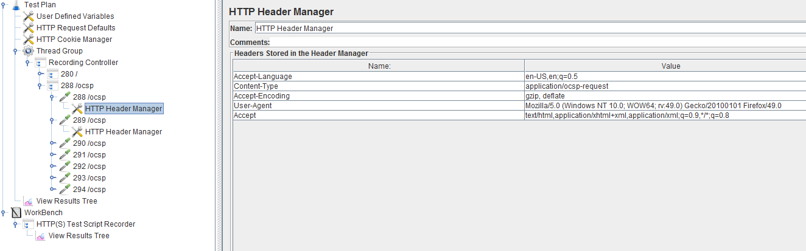
Record access your website

Slide 13
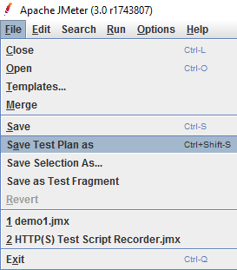
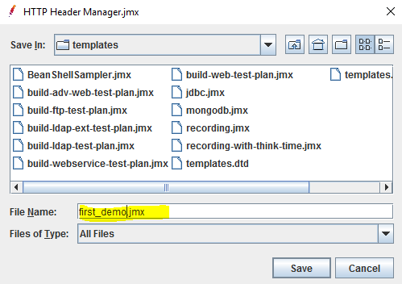
Record save test plan

